Slide 1
Data quality
management

Slide 2
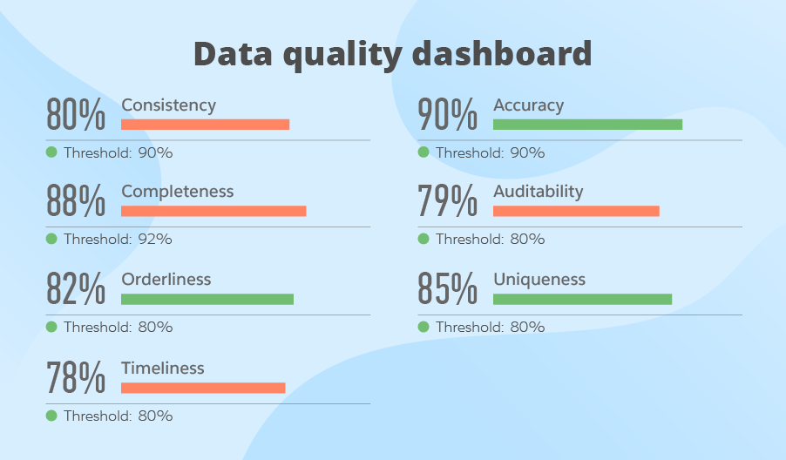
What do we mean?
You can only report what is captured.
For the information to be trusted, data must be captured consistently and accurately.

Slide 3
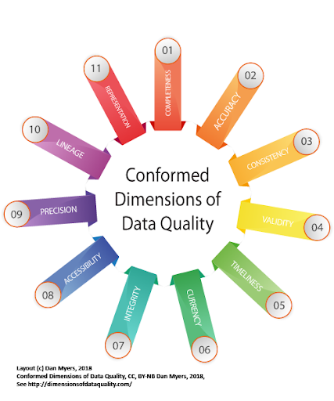
How do we measure data quality?
Consistency: When one piece of data is stored in multiple locations, do they have the same values?
Accuracy: Does the data accurately describes the properties of the object it is meant to model?
Existence: Does the organization have the right data?
Integrity: How accurate are the relationships between data elements and data sets?
Validity: Are the values acceptable?

Slide 4
Data quality management
Data Governance
Data Profiling
Data Matching
Data Quality Reporting
Master Data Management (MDM)
Customer Data Integration (CDI)
Product Information Management (PIM)
Digital Asset Management (DAM)

Slide 5
Data profiling
Calculation of derived values (derived sums, counts, durations) that are then subjected to profiling
Regression analysis
Approximate duplicate analysis using identity resolution tools
Data segmentation and subsequent profiling (for example, profiling customer records segmented by region instead of the entire customer data set)

Slide 6
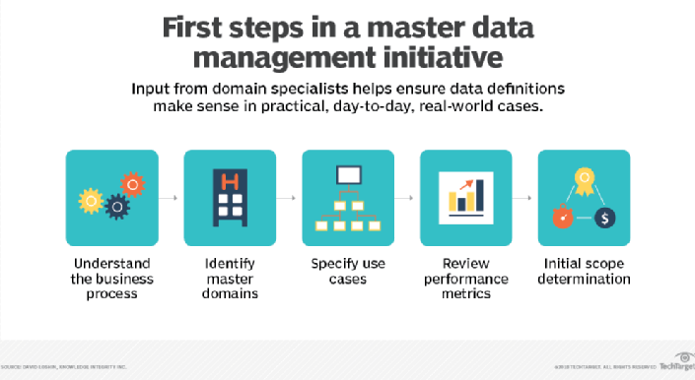
Master Data Management
Master Data Management (MDM) is not just a technological problem.
MDM includes both creating and maintaining master data.
Benefits include a consistent data stewardship experience, a minimized technology footprint, the ability to share reference data across domains, a lower total cost of ownership and a higher ROI.

Slide 7
Best practice ideas
Establish metrics
Perform data quality tests
Establish consistent procedures
Implement a holistic organisation data culture
Consistent data definitions

